Slide 1
Sparse GPU Kernels for Deep Learning
Trevor Gale, Matei Zaharia, Cliff Young, Erich Elsen

Slide 2
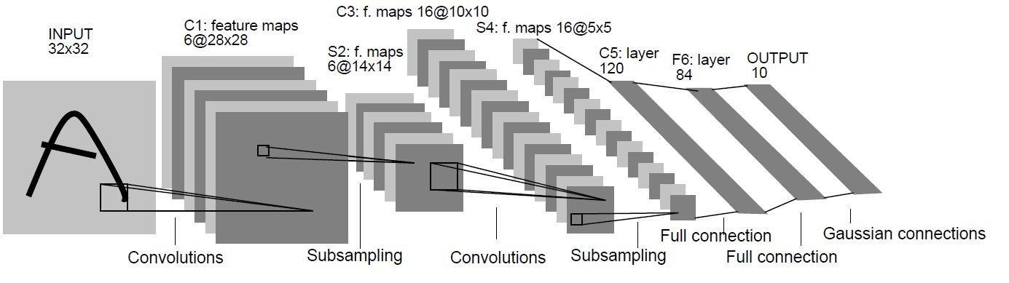
INTRODUCTION
Deep neural network architectures : very big!
But can be made sparse with little to no loss in model quality.
benefit: more efficient in terms of both the floating-point operations (FLOPs) and parameters
required to achieve a given accuracy.
accelerate inference.
faster.
fewer memory usage.
train large model to achieve higher accurcy.

Slide 3
SPARSE MATRICES IN DEEP LEARNING
topology of nonzero values and level of sparsity is very important for sparse matrix.
dataset:
ResNet-50 and Transformer models trained on ImageNet and WMT14 English-to-German respectively.
Including models trained with four different algorithms for inducing sparsity in neural networks.
3,012 matrices from 49 different models.
properties of the matrices:
CoV.
average row length.
sparsity.
Notes:
COV越大， 负载越不均衡。
稀疏度越低，可以更好的利用cache。

Slide 4
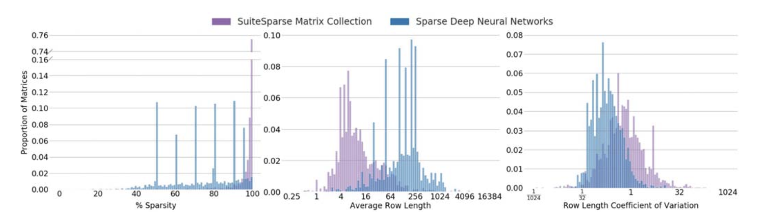
SPARSE MATRICES IN DEEP LEARNING
deep learning matrices :
13.4× less sparse, 2.3× longer rows, 25× less variation
Notes:
也许正是因为这些特性，才能让稀疏的深度学习模型保持高的精确性。

Slide 5
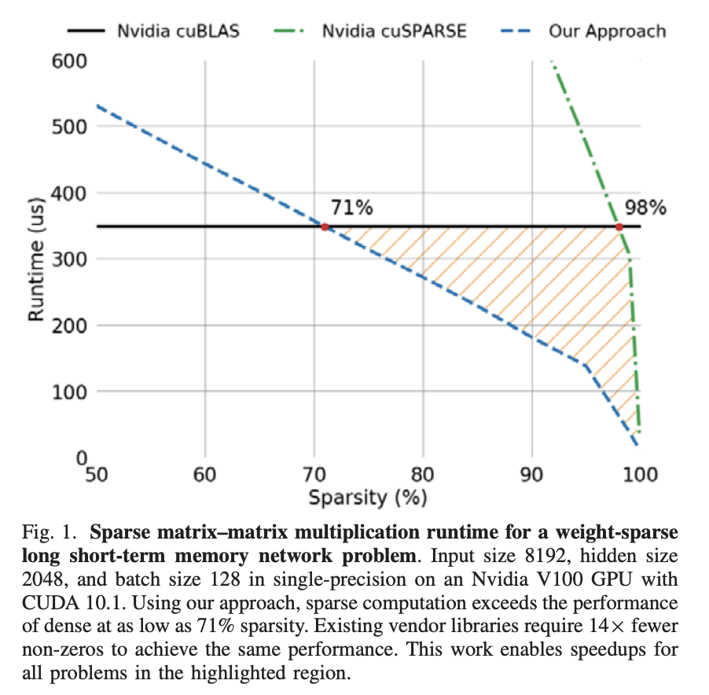
INTRODUCTION
We conduct a large-scale study of sparse matrices found in
deep learning and identify favorable properties.
We introduce a 1-dimensional tiling scheme
We develop two techniques, subwarp tiling and reverse-
offset memory alignment.
We introduce row swizzle load balancing.
sparse Transformer and MobileNet models:
achieve 1.2–2.1× speedups and up to 12.8× memory savings without sacrificing accuracy.

Slide 6
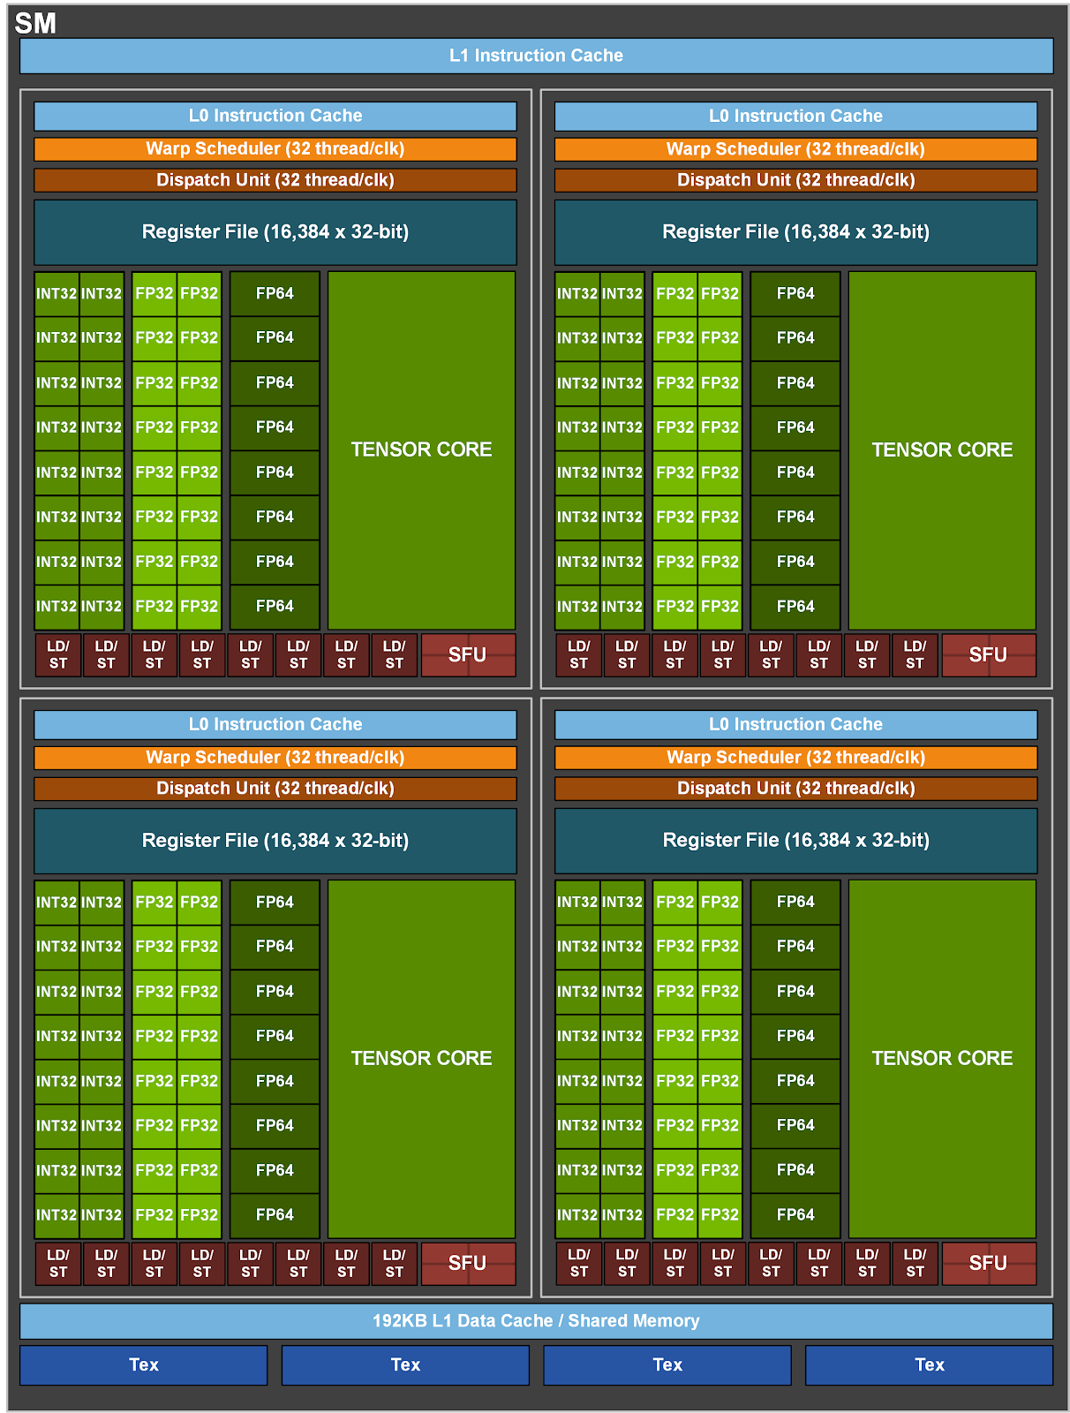
GRAPHICS PROCESSING UNITS BACKGROUND
Threads -> Warps -> Thread Blocks -> Grids
wave:
a set of thread blocks that run concurrently
on the GPU.
occupancy:
The number of thread blocks that
execute concurrently on an SM.
GPUs have a large but high-latency global memory
that is accessible to all SMs.
L2 cache is shared by all SMs,
L1 caches are local to each SM.

Slide 7
SPARSE MATRIX COMPUTATION
Sparse Matrix–Matrix Multiplication Operation:
AB⇒C.
Sampled Dense–Dense Matrix Multiplication Operation:
AB ⊙ C⇒D.
Data Organization
matrices in row-major layout and sparse matrices in CSR format.
BA⇒C, where A is the sparse matrix stored in compressed sparse column format
and B and C are stored column-major would be equally efficient.
Notes:
In the backward pass, the gradient w.r.t. the sparse weights is computed as δY XT ⊙ I[W ]⇒δW.
Transformer models with sparse attention similarly compute QKT ⊙I[Y ]⇒Z in the forward pass.

Slide 8
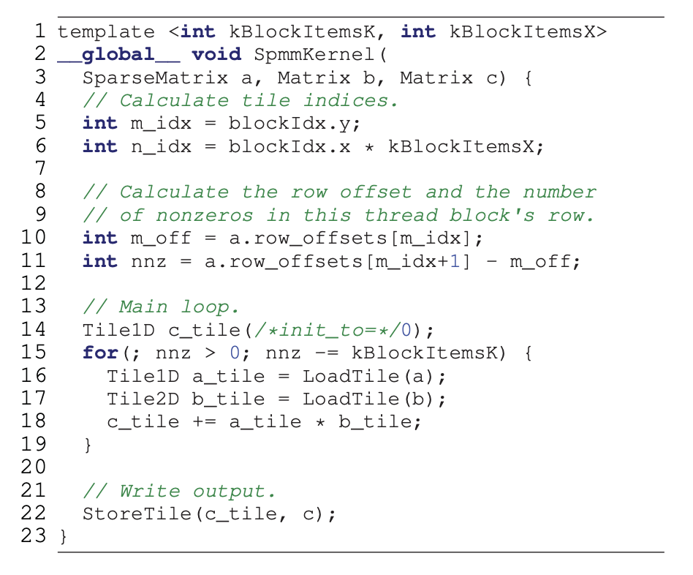
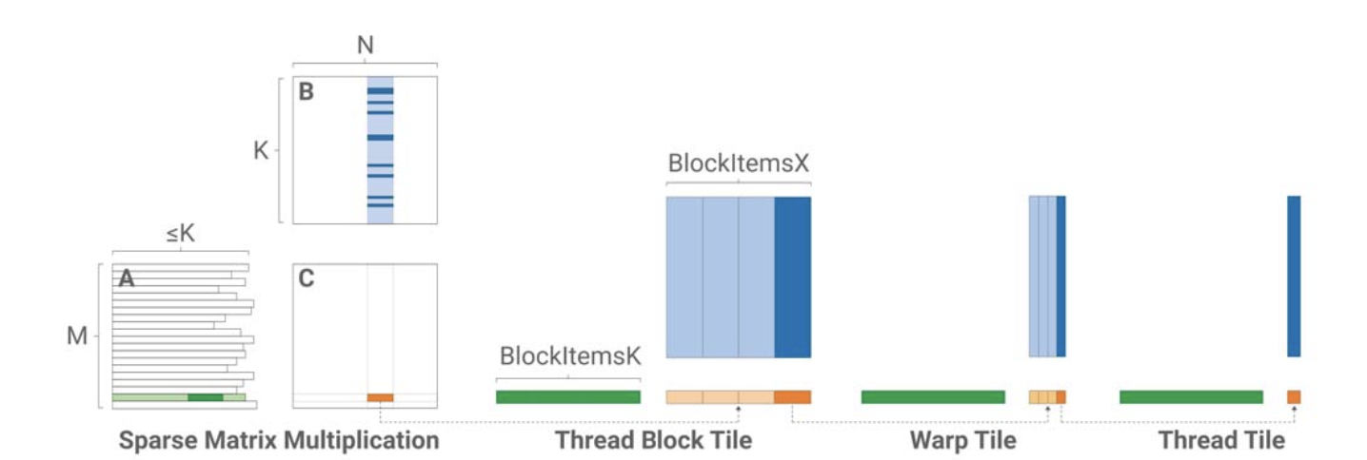
SPARSE MATRIX–MATRIX MULTIPLICATION
Hierarchical 1-Dimensional Tiling
Notes:
Consider various neural network architectures with sparse weight matrices and dense activations. When training RNNs this dimension corresponds to the batch size, which is typically between 16-128 elements [27]. In Transformer architectures, this dimension is the product of the batch size and sequence length, which can vary from 256 to over 2048 elements [2], [28]. In 1×1 convolutions, this dimension is the product of the image height and width with the batch size.
Firstly, easily templatize our implementation for different tile sizes and generate specialized kernel variants for different regions of the problem space.
Secondly, for problems with small M and K dimensions we launch more thread blocks than would otherwise be possible, enabling us to achieve higher occupancy and a higher fraction of peak throughput.
Lastly, processing fixed-sized blocks enables us to aggressively unroll loops and compute offsets and constants at compile time.

Slide 9
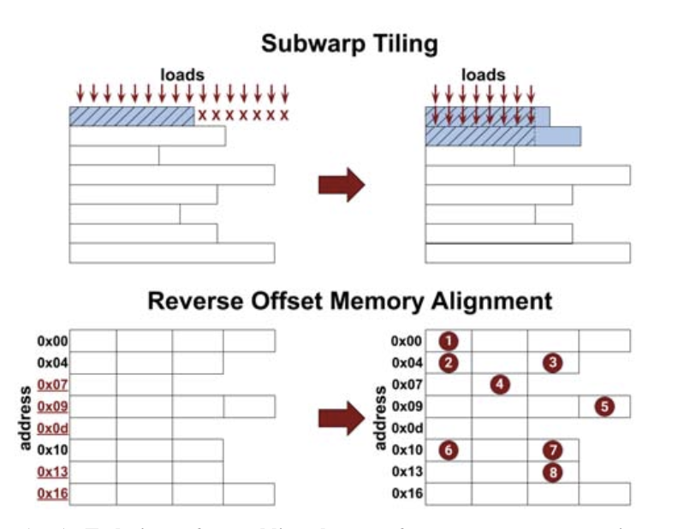
SPARSE MATRIX–MATRIX MULTIPLICATION
Vector Memory Operations
Issues:
Increases the number of values loaded simultaneously
by a thread block.
vector memory accesses require that the target values be
aligned to the vector width.
To solve these issues:
Subwarp Tiling.
Padding? No! Reverse Offset Memory Alignment + Mask.

Slide 10
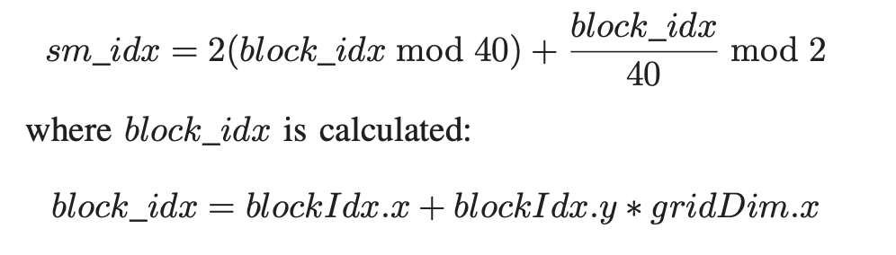
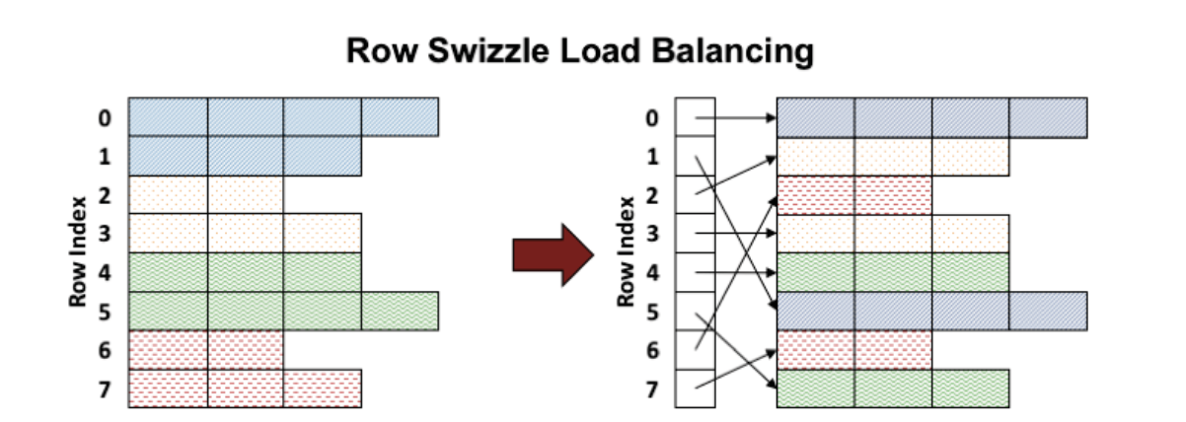
SPARSE MATRIX–MATRIX MULTIPLICATION
Row Swizzle Load Balancing
Load imbalance between warps or thread blocks.
Load imbalance within a warp or thread block.
How to ease it?
Row Binning & Row Bundling.

Slide 11
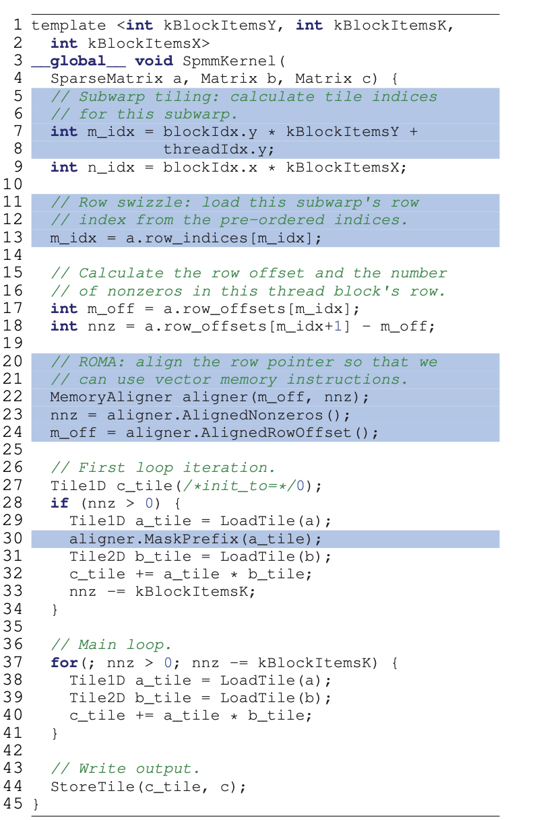
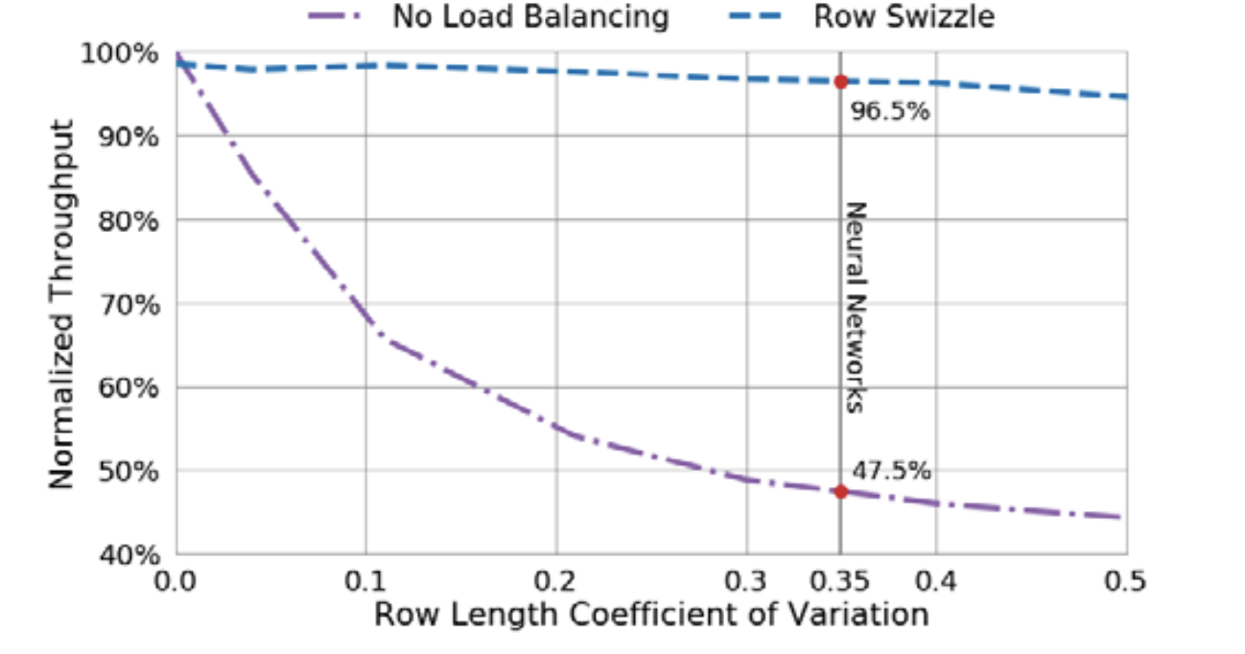
SPARSE MATRIX–MATRIX MULTIPLICATION
Notes:
Implementation Details
Index Pre-Scaling
Residue Handling
Mixed Precision

Slide 12
SAMPLED DENSE–DENSE MATRIX MULTIPLICATION
A. Hierarchical 1-Dimensional Tiling
Instead of mapping thread blocks to 1D regions of the output we map them to 1D strips of consecutive nonzeros.
With the dense matrices stored in row-major layout, naively partitioning the outputs across the threads would
result in strided, uncoalesced memory accesses to the right-hand matrix.
Each thread mapped to an output tile computes a portion of the results for all outputs in that tile.Then reduce
results.
B. Vector Memory Operations
C. Implementation Details
Notes:
load balancing in SDDMM is less critical due to the fact that all dot-products to be computed are of equal length.
Additionally, problems from deep neural networks commonly have a dot- product length that is divisible by the SIMT width, making efficient residue handling less critical than in SpMM.

Slide 13
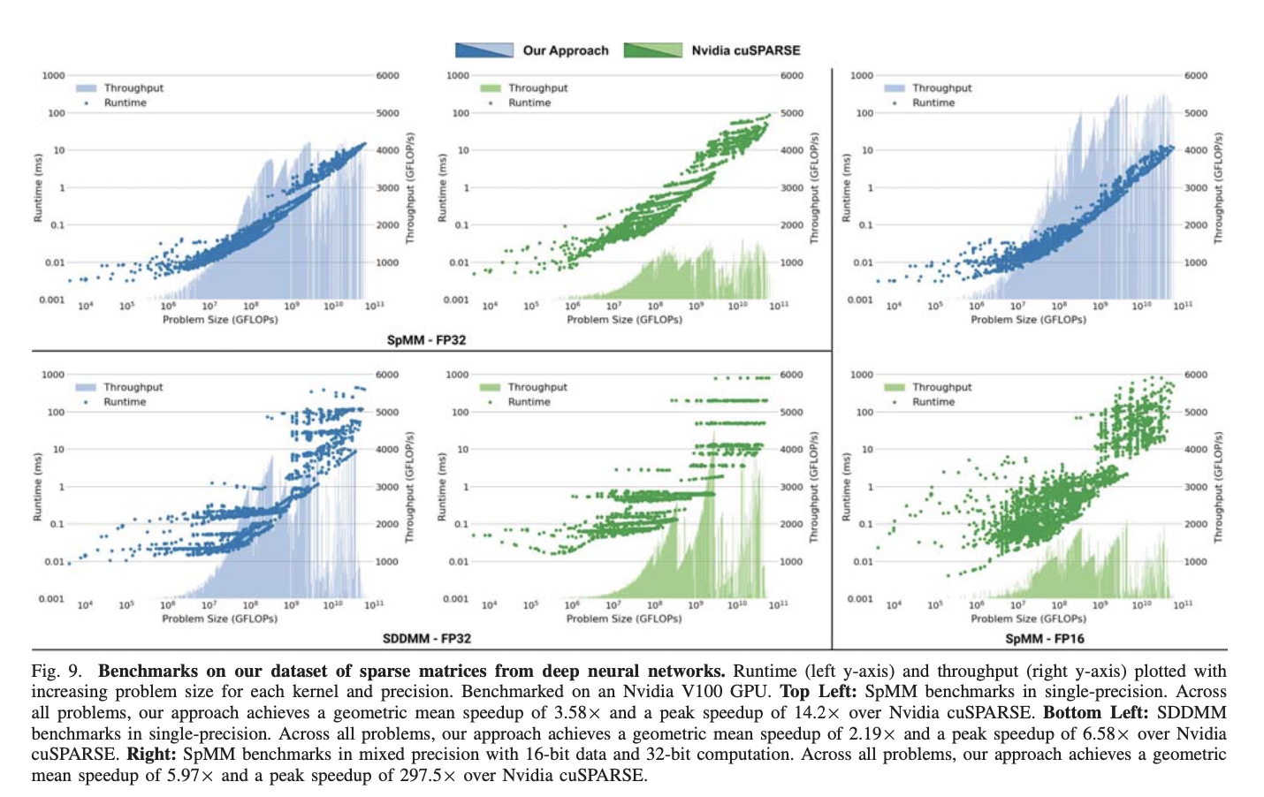
EXPERIMENTS

Slide 14
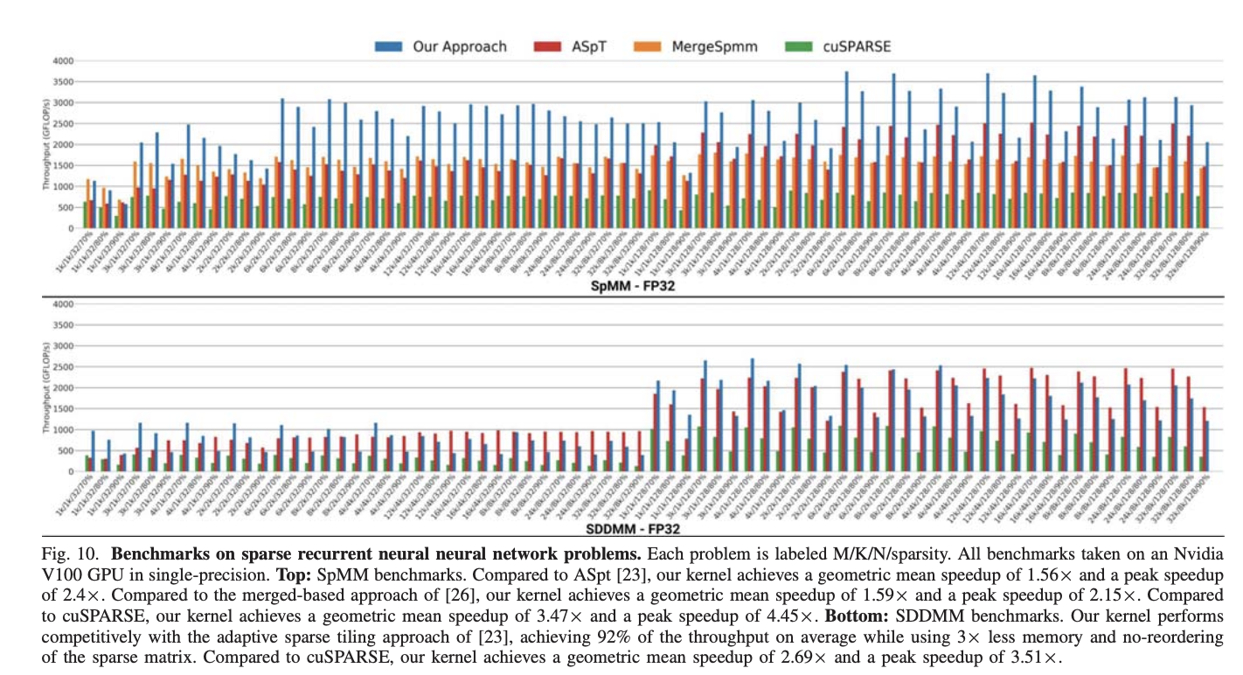
EXPERIMENTS

Slide 15
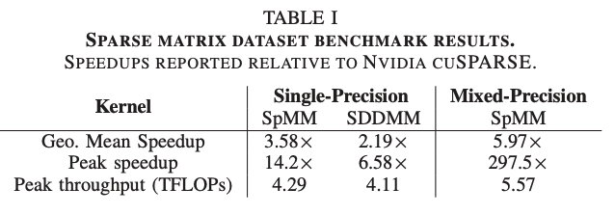
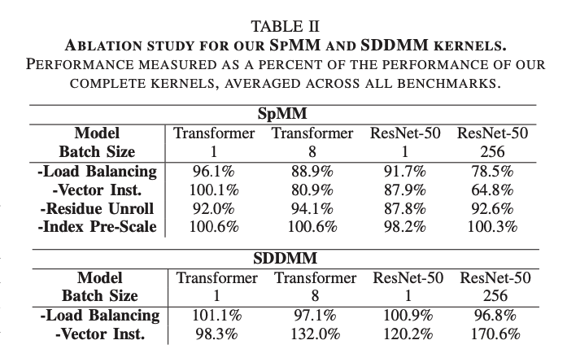
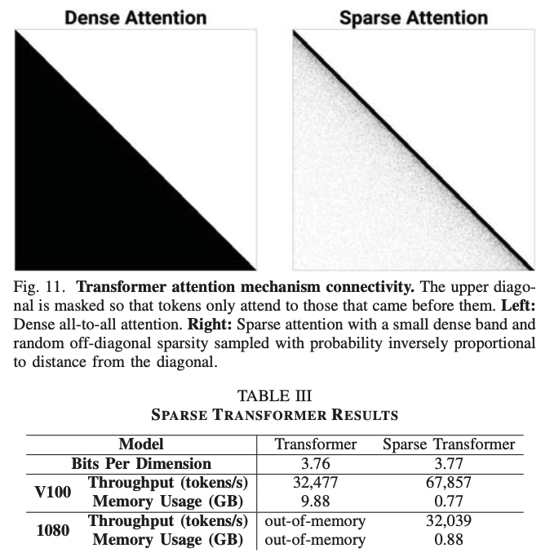
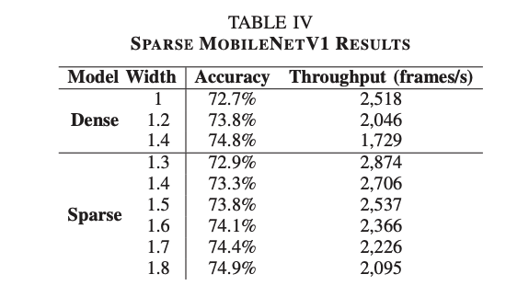
EXPERIMENTS

